Slide 1
EVERY MOMENT( Visit) COUNTS – GOOD HOME VISITS AND POVERTY SUPPORT
Neglect Action Plan 2024 – Helping children and Families Thrive
This Photo by Unknown Author is licensed under CC BY-SA

Slide 2
Today’s briefing
Home visits
Live Well
Housing – District/City responsibilities for rented sector, private and housing associations.
Citizens Advice
Better Housing Better Health
Home-Start
Online resources – food bank

Slide 3
Oxfordshire Joint Strategic Needs Assessment 2022
11% of children in Oxfordshire are estimated to be living in poverty – within the city of Oxford this figure rises to 14%
In 2020-21 there was an estimated total of 14,866 children aged 0-15 lived in low-income families in Oxfordshire and an estimated 18,212 children and young people aged 0-19 (Relative measure Before Housing Costs). 
The rate of child poverty (aged 0-15) in 2020-21 in Oxfordshire was 11.2% of children and was highest in Oxford City (14.3%) and Cherwell (13.1%). 18.5% of children in England were in households in relative low income before housing costs.
Oxfordshire JSNA 2022

Slide 4
Home visits- window into children’s world and lived experience
Private family space – respect and dignity – how would you feel?
Opportunity to be curious and interested in environment – find an item to ask questions-built trust
Be clear on purpose – what do you want to learn and support with?
Leave family being clear on next steps
Tools to help thinking – photos
Look out for locks on the outside of bedroom doors

Slide 5
Live well – how to use
The link to Live Well Oxfordshire is Home | Oxfordshire MarketPlace. There are how to guides under Help to use this site.

Slide 6
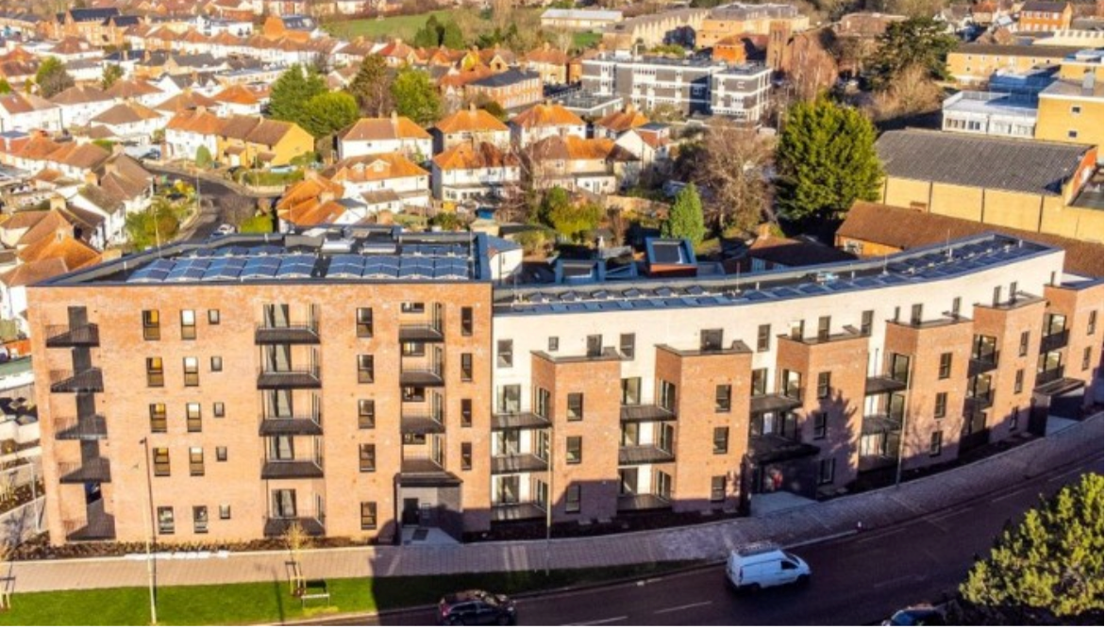
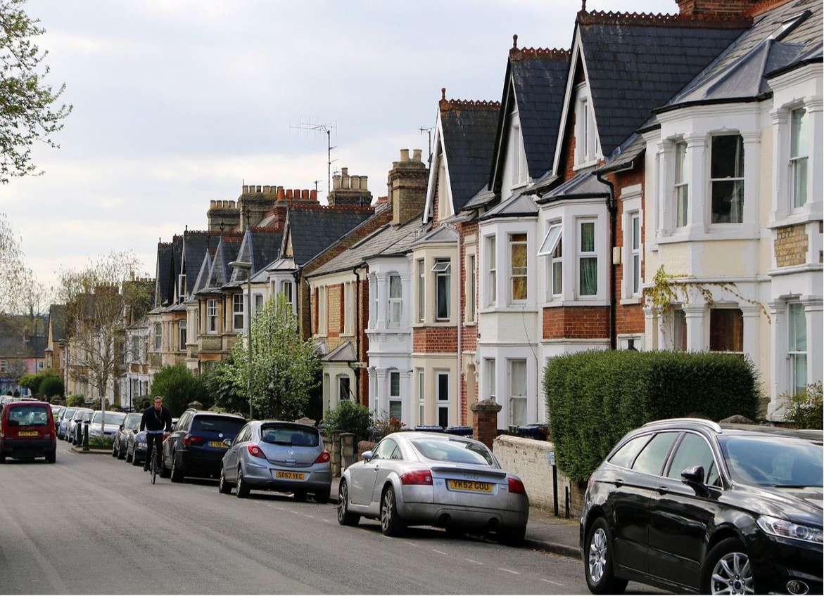
Housing

Slide 7
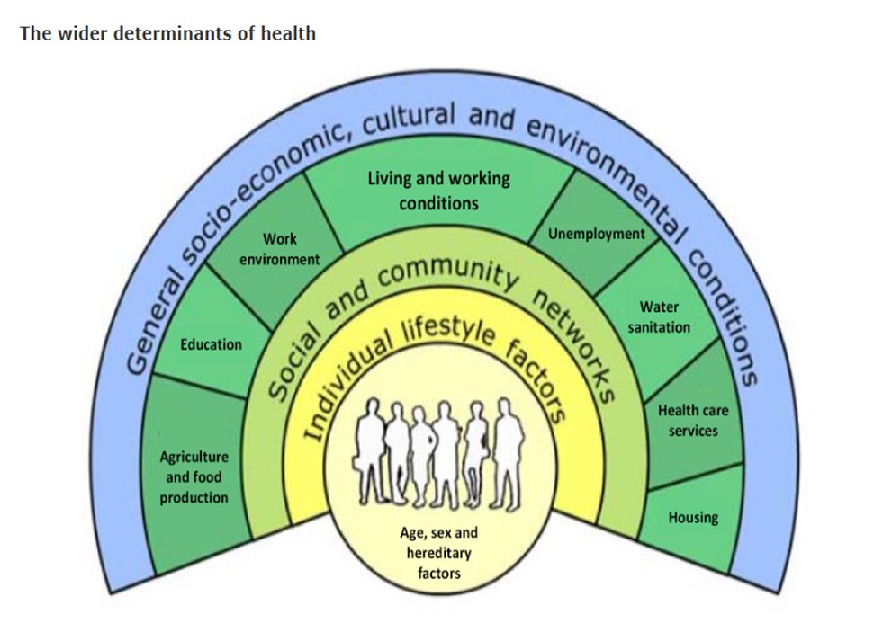
Maintaining housing standards in the private rented sector
Both private sector and social landlords are required to ensure their properties are maintained in good repair and free from serious health and safety hazards. Homes should be warm, safe, and secure.
If tenants experience problems with conditions in their homes, the district and city councils have powers under various pieces of legislation they may use to resolve issues.
Notes:
Impact of housing on health – poor housing leads to poor health and low educational attainment.
If people are worried about housing conditions this is another stress factor in their lives
Living in rented homes, tenants often feel powerless and unsure of where to ask for help and scared of asking for help

Slide 8
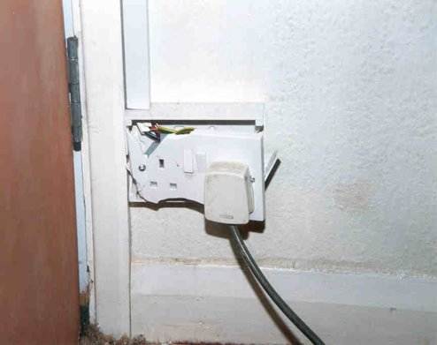
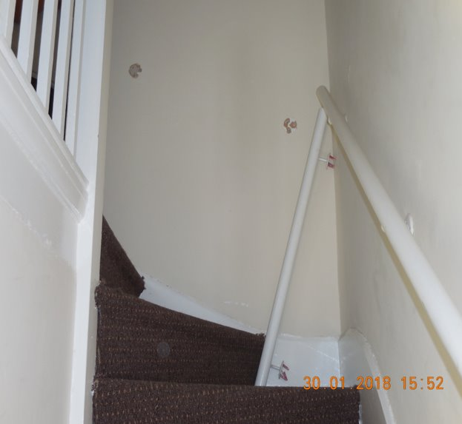
Housing Heath & Safety Rating System
The HHSRS is a risk-based evaluation tool to protect against potential risks and hazards to health and safety in dwellings.
It is not a “standard”.
It identifies significant risks to health, based on the condition of the property.
Common hazards:
Excess Cold and Damp and Mould
Falling hazards
Electrical and Fire hazards
Notes:
Our legislation is risk based. It is not a check-list of what must or must not be provided or fixed.
It looks at the impact on health.

Slide 9
Common issues – Dampness and mould
In cooler autumn/winter months, complaints relating to dampness and mould become more frequent.
People are less inclined to open windows (ventilate) and can’t dry washing outside. High energy costs can also make people hesitant to adequately heat their homes which can also lead to dampness.
Whilst it is sometimes possible to make improvements to homes which makes managing condensation easier (installing additional insulation, mechanical extract ventilation), people may need to modify their lifestyle to prevent excess humidity in the home (e.g. turning extract fans on, putting lids on pots when cooking).
Notes:
Condensation and black mould are common in winter months.
It can be difficult to judge whether it is due to a defect or lifestyle.

Slide 10
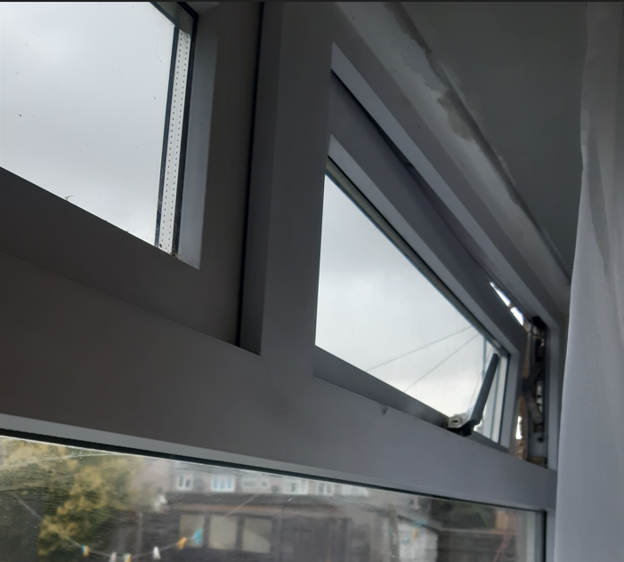
Common issues – Excess Cold
Disrepair to heating systems, broken or ill fitting windows will lead to “excess cold” as homes cannot be heated or efficiently kept warm.
The thermal efficiency of the dwelling (insulation etc) is also important.
Disrepair or poor thermal efficiency is often the cause of damp and mould in a property. The mould is related to condensation due to not being able to keep the property warm.
Under Excess Cold hazard, we are able to take action on disrepair to ensure heating is working and poor fitting windows are fixed and thermal efficiency is improved
Excess cold hazard scores much higher in the HHSRS risk assessment system than damp and mould hazard.
It is much harder for us to take action where the dwelling has no defects and it is occupant lifestyle leading to damp and mould
Notes:
Excess cold is one our the most common problems and is closely linked to damp and mould.

Slide 11
What do I need to look out for and do?
Use your common sense – if it was broken in your house, would you want it fixed?
Has the family mentioned anything that is broken or does not work?
Can you see any signs of damp and mould or other disrepair issues?
Check there is a smoke detector – is it working?
If you are concerned, make a referral to Environmental Health – please gain consent to pass on details or if not, we can give advice however cannot visit
Notes:
When on visits then use your common sense.
Can you spot any problems or items of concern?
Think about your own home – if it broke would you want it fixed?
Ask the family if there is anything of concern, often they are reluctant to ask landlords and fearful of eviction.

Slide 12
Information required for a referral
Name of tenant
Tenants’ address
Your name, role and contact details
The problem / concern
Any vulnerable persons (Child / adults)
If the problem has been reported to the landlord – if so, when and what was the response?
If the visit should be arranged with you or if we can contact the tenants directly
If known - Landlord name
If known - Landlord contact details
We can find out the landlord details if really not known
Notes:
This is the information we need
If the problem has not been reported to the landlord then encourage the person to do this – landlords are not mind-readers. Tenancy agreements are likely to contain a clause requiring the tenant to report problems to the landlord.
Depending on the problem, we may ask the tenant to report to their landlord first.

Slide 13
No names consultation
Email us if you want to discuss a case in confidence without giving the name or address of the tenant.
We cannot visit without informing the landlord – we are legally obliged to give notice of our visits
If we visit and find a serious risk then the Housing Act 2004 places a duty on the council to take action. This is why we are obliged to give notice of the visit.
Notes:
We can give advice via email or phone however we cannot to a joint visit to advise the tenant. We are legally obliged to give 24 hours notice. If we visit and find a problem we are legally obliged to take action.

Slide 14
What happens if I make a referral or a tenant complains?
On receiving a referral, the tenants (or person referring) will be contacted to discuss the complaint.
In order to inspect a property, we are legally required to give 24hrs notice to the owners and occupants and other interested parties (e.g. agents).
We can arrange the visit via social worker / health visitor – please make clear in your referral
Otherwise, we will arrange the visit with the tenant
Officers inspect the property. They will make notes and take photos of problems found.
After the visit, officers assess the property under the Housing Health and Safety Rating System.
From 01 September 2022, Oxford City Council requires all private rented homes to have a licence – this makes it easier to do “proactive” visits e.g. if a tenant is fearful of making a complaint

Slide 15
What happens after the assessment?
If we find significant hazards, we will require the owner to undertake improvement works
Most councils will informally request works, giving the owner time to complete the works
Or we may serve an Improvement Notice which is a legal notice requiring repair
Action will depend on the owner’s willingness to do works, previous history and seriousness of problem, tenants wishes and council corporate policy
Sometimes we may serve:
Hazard awareness notice – this simply advises the owner of problems but does not require them do to work
Tenants are informed of the action taken

Slide 16
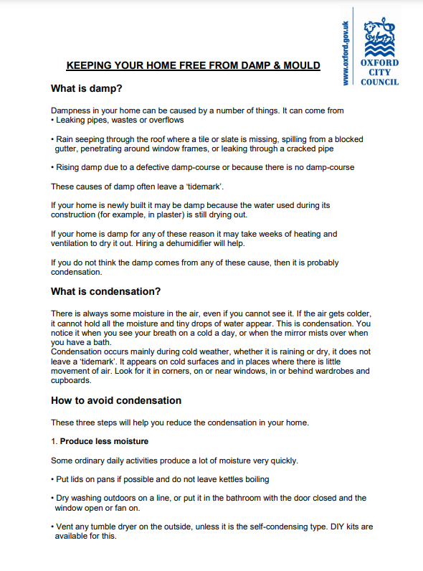
Available advice: damp and mould
Cherwell
https://www.cherwell.gov.uk/info/251/repairs-safety-and-maintenance/235/damp-mould-and-condensation
Oxford City Council
https://www.oxford.gov.uk/info/20271/guidance_for_private_tenants/1129/preventing_damp_and_mould
West Oxfordshire https://www.westoxon.gov.uk/housing/private-housing/advice-for-landlords-and-tenants/tenant-and-landlord-advice/damp-and-mould/
Notes:
Just say here are links

Slide 17
Contact details for disrepair complaints
Cherwell District Council
Tel: 01295 227004
Email:Housing.standards@cherwell-dc.gov.uk
Oxford City Council
Tel: 01865 252658
Email: psst@oxford.gov.uk
South and Vale
Tel: 01235 422436
Email: PSH@southandvale.gov.uk
West Oxfordshire
Tel: 01993 861000
Email: customer.services@westoxon.gov.uk
Notes:
Here are contact details

Slide 18
Contacts for fire checks
Fire.SafeandWell@Oxfordshire.gov.uk
www.365alive.co.uk
fire.service@oxfordshire.gov.uk
T: 01865 842 999 (Mon-Fri 0900-1700hrs only). Out of hours: 0118 358 9333
Lead: Julie Jordan
Tel: 07771941664 (Mobile)
julie.jordan@oxfordshire.gov.uk
Safe and Well referrals for advice – non urgent, more aimed at over 65s however if there were hoarding or other neglect issues leading to fire safety risks https://www.oxfordshire.gov.uk/residents/fire-and-public-safety/fire-and-rescue-service/safe-and-well-visit
Notes:
More contact details

Slide 19
Maintaining housing standards in the owner occupied sector
Home Improvement Agencies can help older, disabled and vulnerable residents within Oxford City to live safely and independently in their own home.
The agency service is available to people who are vulnerable and need help repairing, maintaining or adapting their home.
Oxford City Council 01865 252788
South & Vale 0300 373 5663
Cherwell District Council 01295 227004 / 01295 227022
Notes:
Impact of housing on health – poor housing leads to poor health and low educational attainment.
If people are worried about housing conditions this is another stress factor in their lives
Living in rented homes, tenants often feel powerless and unsure of where to ask for help and scared of asking for help

Slide 20
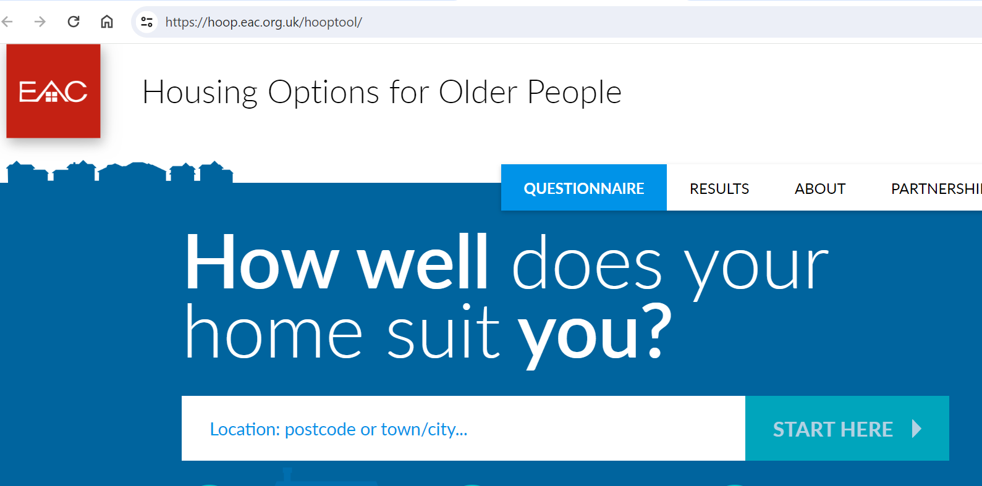
Maintaining housing standards in the owner occupied sector
Housing Options for Older People (HOOP) is a technique for appraising your current housing and options for moving and will help you identify what information you need, and help you find it. It may also make you aware that some advice or other help would be welcome, and if so, will guide you to the most appropriate agency to provide this. Visit the HOOP website.
Notes:
Impact of housing on health – poor housing leads to poor health and low educational attainment.
If people are worried about housing conditions this is another stress factor in their lives
Living in rented homes, tenants often feel powerless and unsure of where to ask for help and scared of asking for help

Slide 21
How to Use
Citizens Advice provide free, impartial and confidential information, advice and support on a wide variety of topics.
Where possible, we encourage people to first see if the information on the national Citizens Advice website will be sufficient to meet their needs as the local services are extremely busy due to rising demand driven by the cost-of-living crisis.
People can self-help using information and guidance on the Citizens Advice website www.citizensadvice.org.uk
If people can’t self-help or need more support, they can find out how to access their local Citizens Advice service on the local website www.caox.org.uk

Slide 22
In a preventative approach to health and wellbeing, the BHBH+ home visit service provides vulnerable residents with face to face expert advice to help increase the energy efficiency of their home, reduce energy usage safely and improve wellbeing.
Funded by Oxfordshire County Council and others

Slide 23
Helpline and Home Energy Visit
When should you refer someone?
If you believe the household is experiencing any of the following issues:
Struggling to pay for or understand their energy bills / has energy debt
Struggling to understand and set their heating controls
Is living in a cold home
Has a broken heating system or is using a temporary heater
Home has signs of damp / condensation / mould
Wearing lots of blankets / layers / winter coat indoors /only heating one room
Socially isolated / reluctant to have visitors – this can be an indication that there may be an energy related issue
For a checklist for what to look out for “Favourite” this page.

Slide 24
How can we help?
General home energy related interventions
Energy bills and metering issues
Understanding and help to set heating controls
Gas/electric/water priority services register (free support for vulnerable customers)
Fuel voucher top ups for pre-payment meters (subject to funding)
Warm Home discount advice
Energy debt advice signposting
Signposting and some access to the Household Support Fund (for help with household costs)
Government financial support for energy bills

Slide 25
Contact us
0800 107 0044
www.bhbh.org.uk
@bhbhadvice

Slide 26
Home-visiting support
For families in Oxfordshire

Slide 27
For families with at least one child under 5 (including pregnancy)
Holistic – for families experiencing stress when their children are young
Emotional and practical support
Weekly home-visits & groups
Support poverty, family hardship and housing needs in the context of wider difficulties
Confidential, no judgement
Free
Notes:
To explain – trained volunteers and expert staff

Slide 28
Observations & Wider impacts
What have we seen? Shame Isolation – denied friendships Self-esteem, parenting capacity Further negative impacts for child development – 1001 critical days
Notes:
Examples
Toddlers living indoors in snow suits
Family unable to attend an outdoor play session as couldn’t afford washing or to get warm afterwards
Cancelled visits as not been able to get on top of washing, house a mess
Families taking only no-cook food from The Larder
Observations from groups – mum and children all filling up on toast until it was gone; people taking food bags as soon as they arrive, lingering at the end to see if there’s any food left.
We’ve seen this need coming from all sections society, so being alert to widespread hardship need.

Slide 29
Scenarios:
Help form-filling
Advocacy on housing
Access grants for white goods, beds etc.
Access to food bank, larder, free play opportunities, attending appointments e.g. Advice Centres
Energy & Cost of Living Toolkit & Checklist to use with a family
https://homestartoxford.org.uk/2023-updated-energy-and-cost-of-living-resource/

Slide 30
Find your local Home-Start & Refer / Self-Refer www.homestartoxon.org.uk

Slide 31
This Photo by Unknown Author is licensed under CC BY-NC-ND

Slide 32
Useful links
Fact sheets - Malnutrition (who.int)
Child Malnutrition & COVID-19 in the UK (nnedpro.org.uk)
Covid 19’s devastating impact on malnutrition - Action Against Hunger
Creating a culture and ethos of healthy eating - GOV.UK (www.gov.uk)
https://learning.nspcc.org.uk/child-abuse-and-neglect/neglect#heading-top
Eating well early years — First Steps Nutrition Trust
Healthy eating and safe food preparation | From pregnancy to children aged 5 (foundationyears.org.uk)
Nutrition Matters for the early years 0118.pdf (hscni.net)
Example menus for early years settings in England - GOV.UK (www.gov.uk)
Tools - Oxfordshire Safeguarding Children Board (oscb.org.uk)

Slide 33
Resources
Eating well early years — First Steps Nutrition Trust
You can find information about eating well in the first year in our Infant & New Mums section. Children from 1-4 years old need to eat well to establish good eating patterns, ensure they grow and develop appropriately, to protect their teeth and to ensure they arrive in school at a healthy body weight able to enjoy a variety of minimally processed foods.
Healthy eating and safe food preparation | From pregnancy to children aged 5 (foundationyears.org.uk)
This includes preparing food hygienically, providing meals that are healthy, balanced and nutritious, as well as making sure that food is prepared appropriately for babies and children of different ages
Nutrition Matters for the early years 0118.pdf (hscni.net)
Example menus for early years settings in England - GOV.UK (www.gov.uk)
Eat Them To Defeat Them | Achieve Oxfordshire Good Food Oxford | Oxfordshire's Sustainable Food Network

Slide 34
Good Food Oxford
Oxfordshire's Sustainable Food Network | Good Food Oxfordshire
Notes:
Data from Unicef found that 19 per cent of UK children under the age of 15 live with a respondent who is moderately or severely food insecure and that 10.4 per cent (the highest proportion anywhere in Europe) live with someone who is severely food insecure. Other research shows that families with children are also increasingly turning to charitable organisations for help with food.

Slide 35
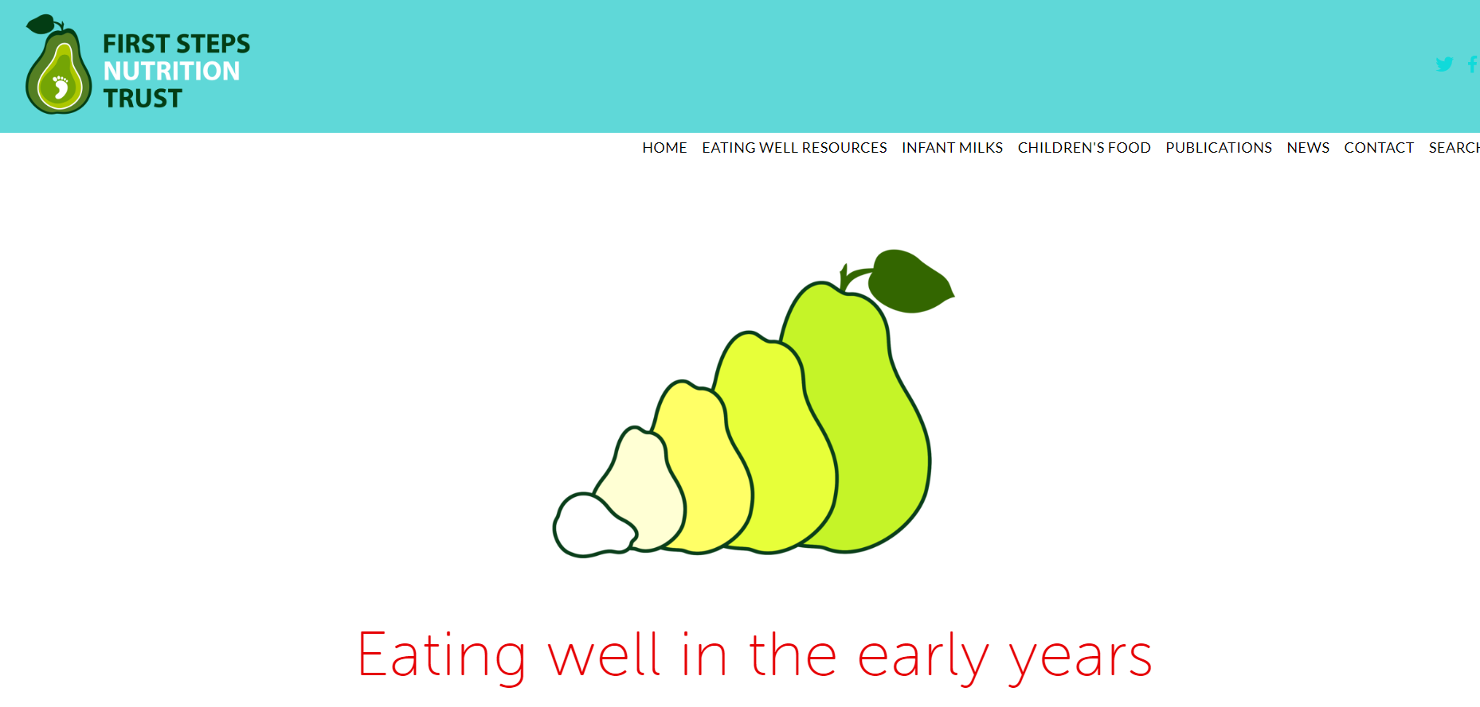
What food do you provide?
Eat Better, Start Better - Foundation Years
The Eatwell Guide - GOV.UK (www.gov.uk)
Notes:
Our Eat Better, Start Better guidance and supporting material have been developed to help early years providers and practitioners to meet the Early Years Foundation Stage welfare requirement for the provision of healthy, balanced and nutritious food and drink.
More links at the end of the section.

Slide 36
Loan Sharks
Stop Loan Sharks investigates and prosecutes illegal money lenders and provides support for borrowers in the UK.
If you have borrowed from a loan shark or are worried about someone else, we’re here to help and keep you safe.
Our specially trained staff will provide you with emotional and practical support that is tailored to your needs.
Call us 24/7 on 0300 555 2222 or start a Live Chat
www.stoploansharks.co.uk

